Slide 1

BANGLADESH ARMY UNIVERSITY OF ENGINEERING AND TECHNOLOGY
COURSE Tittle : Bangladesh studies: History and Culture
COURSE code :1151

Slide 2
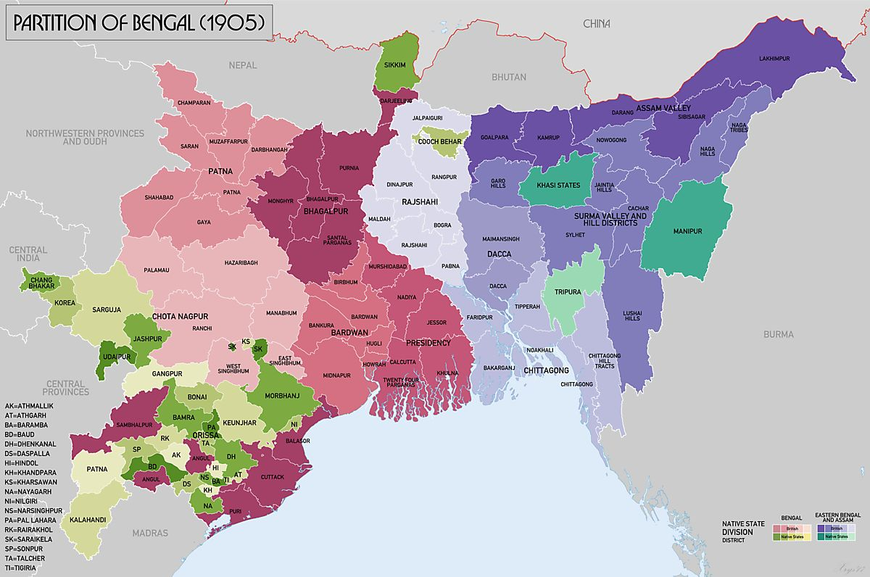
Bengal Partition

Slide 3
PRESENTED BY
Tawfik Rahman Shabab

Slide 4
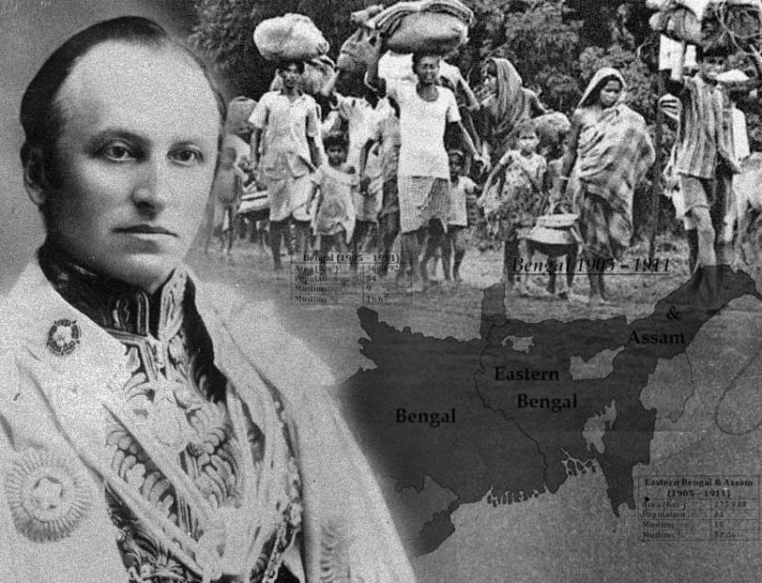
Lord George Nathaniel Curzon
(1859-1925)

Slide 5


East Bengal and Assam
West Bengal and Bihar
16 OCT 12 SEP

Slide 6
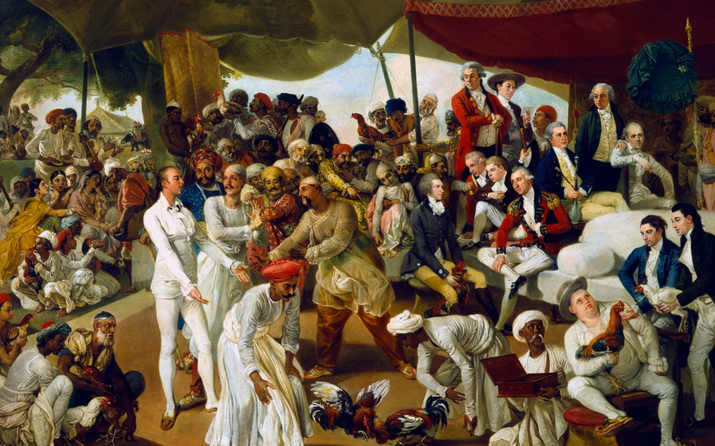
Theory:
Administritive
Economical
Political

Slide 7
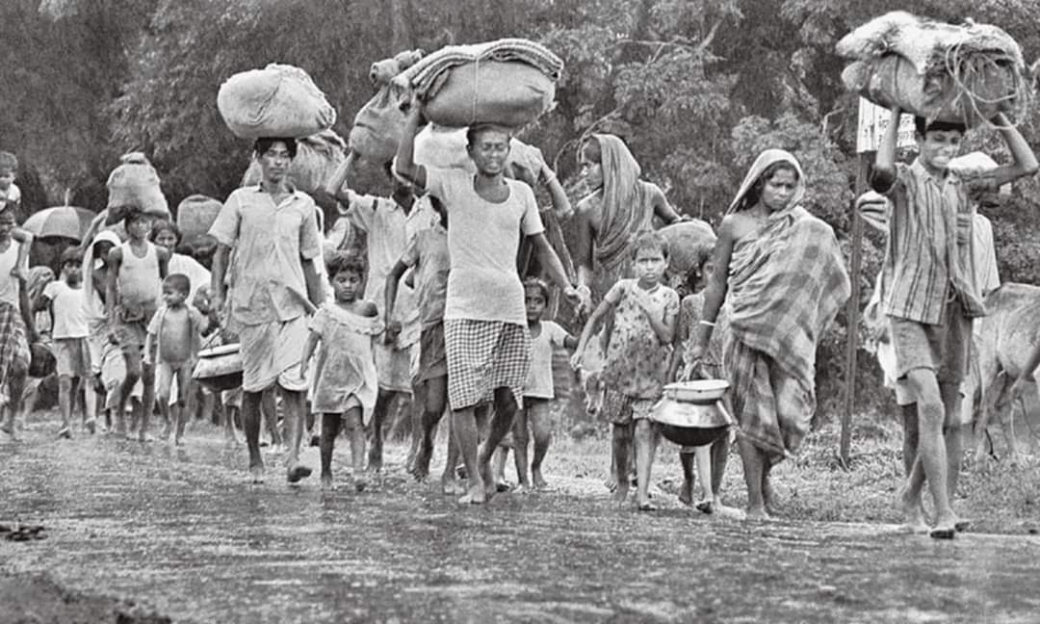
Reason/Cause:
Huge area
Cultural and religious diversity
Communication issues
Economic consideration
Nationalism

Slide 8
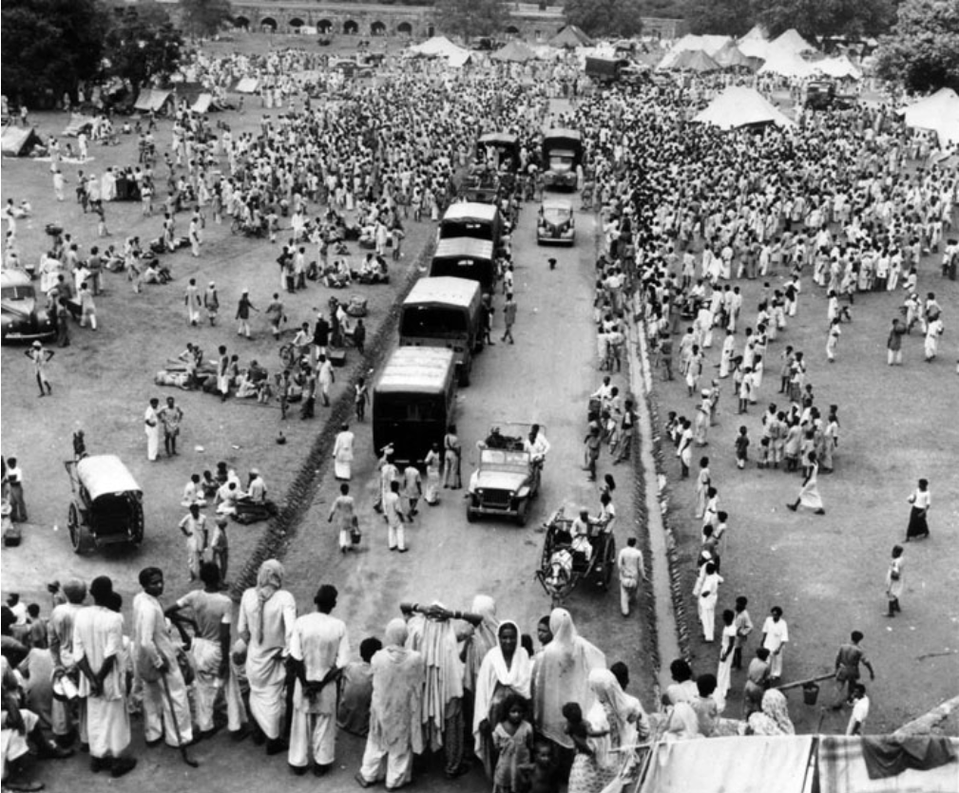
Consequences:
Rise of Nationalsim
Unity of Muslims
Reversal of partition
Impact on British policey

Slide 9
Fin

